Slide 1


The Ethical Debate of Blackbaud Inc.’s 2020 Confidentiality Breach
Mr. Traver Yates, MCP
Ethical and Legal Issues in the Professions: ETHC232
Professor Aprille Campbell
June 22, 2021
Notes:
A title slide that features your topic selection, your name, DeVry University, and the course identifier (ETHC232)

Slide 2

Define Confidentiality
According to Dictionary of Ethical and Legal Terms and Issues: The Essential Guide for Mental Health Professionals, Confidentiality can be defined as "the requirement, with some exceptions that practitioners would not reveal to others the content of information communicated by the client…" (Sperry, 2006)
This Photo by Unknown Author is licensed under CC BY-SA
Notes:
A slide that defines the ethical term you chose in Week 2; include a citation on the slide for the definition you used

Slide 3

Blackbaud Inc., Data Breach of 2020
During 2020, Blackbaud Inc. networks was hacked into, and data stolen of over more than 100,000 individuals. Those individuals being both customers of Blackbaud Inc. and their customers clients.
Since Blackbaud Inc, is facing multiple class-action suits in the USA and Europe. With accusations ranging from neglecting their own security and policies to failing to promptly notify the clients and authorities of the breach.
This Photo by Unknown Author is licensed under CC BY-ND
Notes:
A slide that depicts the case you selected This can be an image or visual only (a picture that is worth a thousand words) to show the case that you narrate in your presentation. Include a citation on the slide for the photo or image you used.

Slide 4

The Ethical Dilemma
Breach of Confidentiality
Blackbaud Inc. did keep clients and customers in the know publicly
Accused of failing to properly train their own employees
Failure to implement the necessary security protocols and upholding them
Delayed reporting of breach to authorities and publicly
This Photo by Unknown Author is licensed under CC BY-SA
Notes:
A slide that lists the ethical dilemma and the three theories; cite sources on the slide

Slide 5
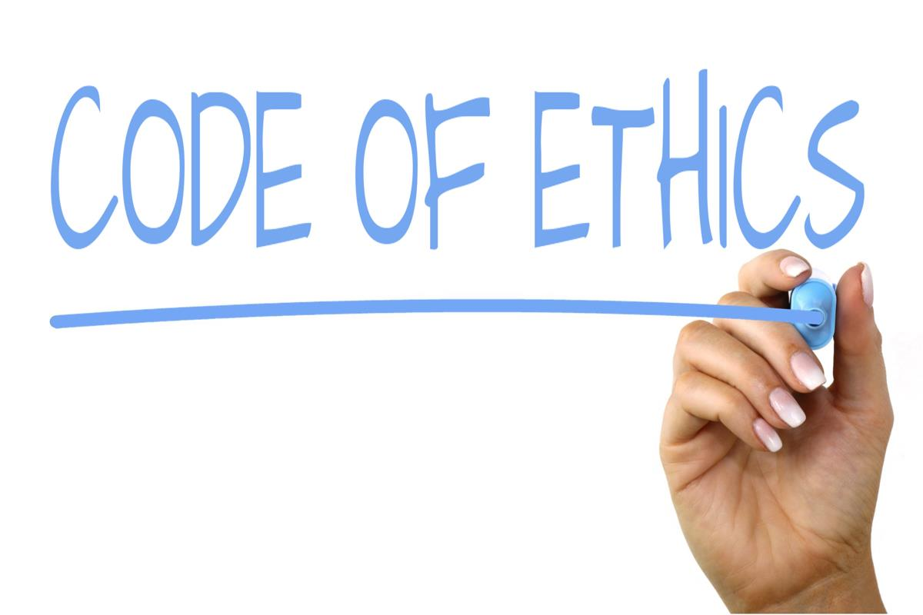
Application of Codes and Laws
Blackbaud Inc. violated their own code of business conduct, which includes “Computer Resources and Email” and “Confidentiality, Privacy, and Information Security” sub-codes.
  (“Code of Business Conduct and Ethics of Blackbaud, Inc.,” 2021)
Violations of various state laws concerning notification In cases of confidentiality breach
This Photo by Unknown Author is licensed under CC BY-SA
Notes:
A slide that shows which laws or codes apply; cite sources on the slide

Slide 6
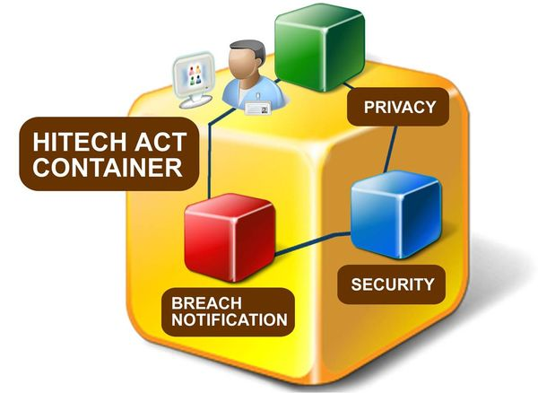
Application of Codes and Laws
Continued…
Failure to timely notify customers and public of a break in confidentiality as per HIPAA and HITECH. (Health Insurance Portability and Accountability (HIPAA) & HITECH Acts, n.d.)
Failure to promptly notify the appropriate authorities, file report and make public the breach according to GPDR rules. (Data Protection Law: An Overview, 2019)
This Photo by Unknown Author is licensed under CC BY-SA
Notes:
A slide that shows which laws or codes apply; cite sources on the slide

Slide 7

Potential Solutions and Impacts
Employee Awareness
  Tempering with credentials
  Selling of data
  Checks and balances
  Network monitoring
  Lockdown of systems
    USB/Removable drives
    Changing passwords
    (Schute, 2018)
This Photo by Unknown Author is licensed under CC BY
Notes:
A slide that gives possible solutions and impacts on stakeholders

Slide 8

Potential Solutions and Impacts
Continued…
Security Incident Response Plan
  Conduct A Risk Assessment
  Identify Your Cyber Vulnerabilities
  Decide When To Rise The Alarm
  Develop A Detection Plan
  Gather Your Team
  Inventory Assets And Resources
  Plan Your Incident Response
  Draft Your Communications Now
  Create A Cybersecurity Event Log Template
  Remain Vigilant For Threats
  Secure Cyber Liability Insurance
  (Forming a Cyber Attack Response Plan - Cyberlock Defense, 2020).
This Photo by Unknown Author is licensed under CC BY
Notes:
A slide that gives possible solutions and impacts on stakeholders

Slide 9
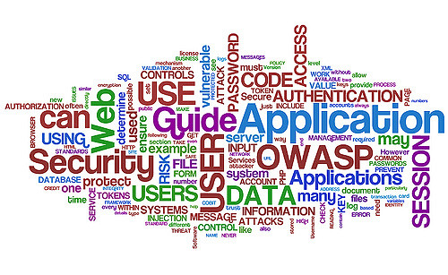
Applying the Solutions
Blackbaud Inc. needs to address how they failed to follow their own code of business and ethics
Evaluate their timely response and address changes for future incidents
Strengthen their network security, policies and monitoring
Increase the transparency with the public by sharing their policies, internal audits and additional information regularly.
This Photo by Unknown Author is licensed under CC BY-NC
Notes:
A slide that gives your solution and your rationale for choosing it

Slide 10
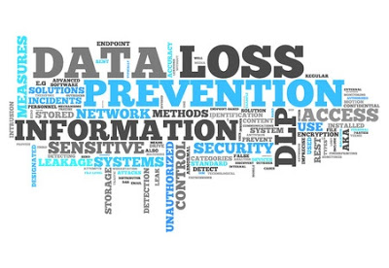
Future Incidents, How Can Things Can Repeat
Failing to update policies
Not strengthen their network
Properly training employees
Improperly monitoring
Timely responses to incidents
This Photo by Unknown Author is licensed under CC BY-SA
Notes:
A slide that shows where, how, when, or why the situation can occur in the workplace of the future

Slide 11

Blackbaud Inc.’s Future Response
Blackbaud Inc. is facing many class-action suits both in the USA and Europe, with no resolution from them yet. Its hard to speculate on the future of Blackbaud Inc. No, they are not in trouble of closing; however, their reputation is tarnished.
With those last words, its time for Blackbaud Inc. to regroup. Evaluate their companies' policies, those of their partners and work on strengthen their security.
This Photo by Unknown Author is licensed under CC BY-SA
Notes:
A slide that gives advice or tips on how to handle the dilemma when it does occur

Slide 12
References
Code of Business Conduct and Ethics of Blackbaud, Inc. (2021). In Code of Business Conduct and Ethics of Blackbaud, Inc. Blackbaud, Inc. https://investor.blackbaud.com/static-files/bf9c3696-073d-4ca2-b0e6-0128082792d5
Data Protection Law: An Overview. (2019). https://fas.org/sgp/crs/misc/R45631.pdf
Department of Health & Human Services USA. (2013). OFFICE RIGHTS FOR CIVIL Privacy, Security, and Electronic Health Records 1 PRIVACY, SECURITY, AND ELECTRONIC HEALTH RECORDS. https://www.hhs.gov/sites/default/files/ocr/privacy/hipaa/understanding/consumers/privacy-security-electronic-records.pdf
General Data Protection Regulation (GDPR). (2013). General Data Protection Regulation (GDPR). https://gdpr-info.eu/art-33-gdpr/
Art. 33 GDPR- Notification of a personal data breach to the supervisory authority
Health Insurance Portability and Accountability (HIPAA) & HITECH Acts. (n.d.).
HITECH Act Summary. (2009). Hipaasurvivalguide.com. http://www.hipaasurvivalguide.com/hitech-act-summary.php
Schute, D. A. (2018). Prevent cyber attacks: Don’t overlook the human element. Dermatology Times, 39(12), 68–68. Consumer Health CompleteEBSCOhost. http://search.ebscohost.com/login.aspx?direct=true&db=c9h&AN=133475908&site=ehostlive
Security Incident. (2020, August 29). Blackbaud. https://www.blackbaud.com/securityincident
Sperry, L. (2006). Dictionary of ethical and legal terms and issues : the essential guide for mental health professionals. Routledge.
Notes:
References slide Sources must be cited on individual slides and documented on a References slide using APA style.

